Slide 1
ECE-9 Acoustic Awareness Enabler
Team Members:
Professor: | Dr. Paul Fortier
Customer: | Dr. Karen Payton
Advisor: | Dr. W Vance McCollough
Drew Martins | Team Lead and Programmer
Ryan Dumont | Electrical Design Engineer
Stephen Felix | Test Engineer
Michael Benker | Systems Engineer
Jared Alves | Signal Processing Engineer

Slide 2

ECE-9 Acoustic Awareness Enabler

Slide 3
Engineering Requirements
Customer Requirements |  | Engineering Requirements
1 | Self-containment of power source (rechargeable) and battery life of 8 hours | 1.1 8 hours power supplied to device
2 | 3.5mm audio jack for input | 2.1 Audio Source input 3.5mm
 |  | 2.2 Audio Source Output 3.5mm
 |  | 2.3 I/D Interface – digital pot/switch
3 | Must have 3 different levels of interruption noise sensitivity | 3.1 Record data and process using MATLAB
 |  | 3.2 Three Separate Sensitivity Buttons
4 | When interruption is detected, audio is muted | 4.1 Use of potentiometers/switches to attenuate audio
5 | Must be able to distinguish between ambient and interrupt with a 1% false interrupt detection rate | 5.1 Data analysis for algorithm to achieve a 1% false detection rate or better
 |  | 5.2 Lowest Ambient Noise of 30 dB
 |  | 5.3 Must have 100 Hz Sampling frequency
 |  | 5.4 Need a sound level detector
6 | Must have a reset button to restart audio | 6.1 Physical reset button
 |  | 6.2 Switches resume audio after being turned off
 |  | 6.3 Recalibrate device, delay further interrupts for 20 seconds while gathering data
7 | Separate audio cable between device and audio source | 7.1 Included with final product

Slide 4
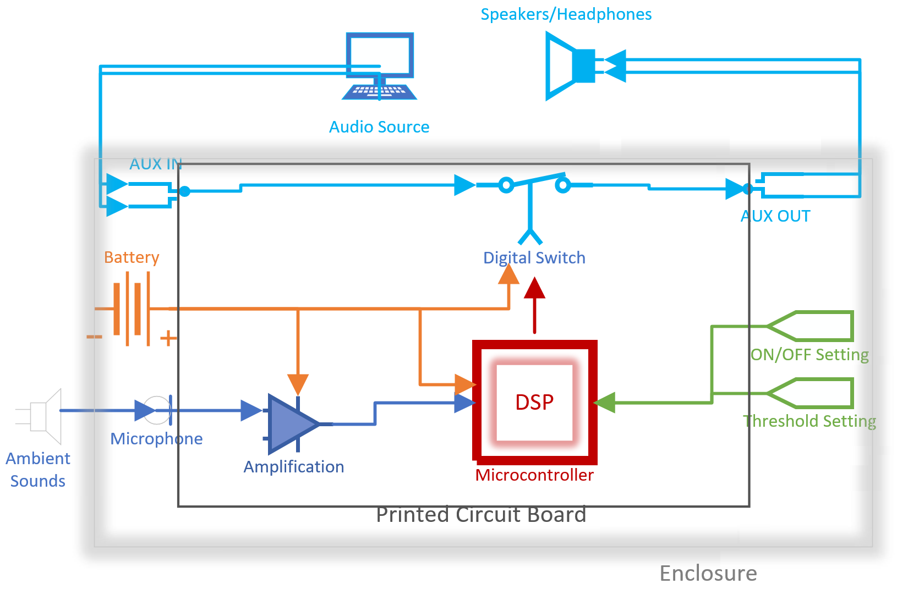
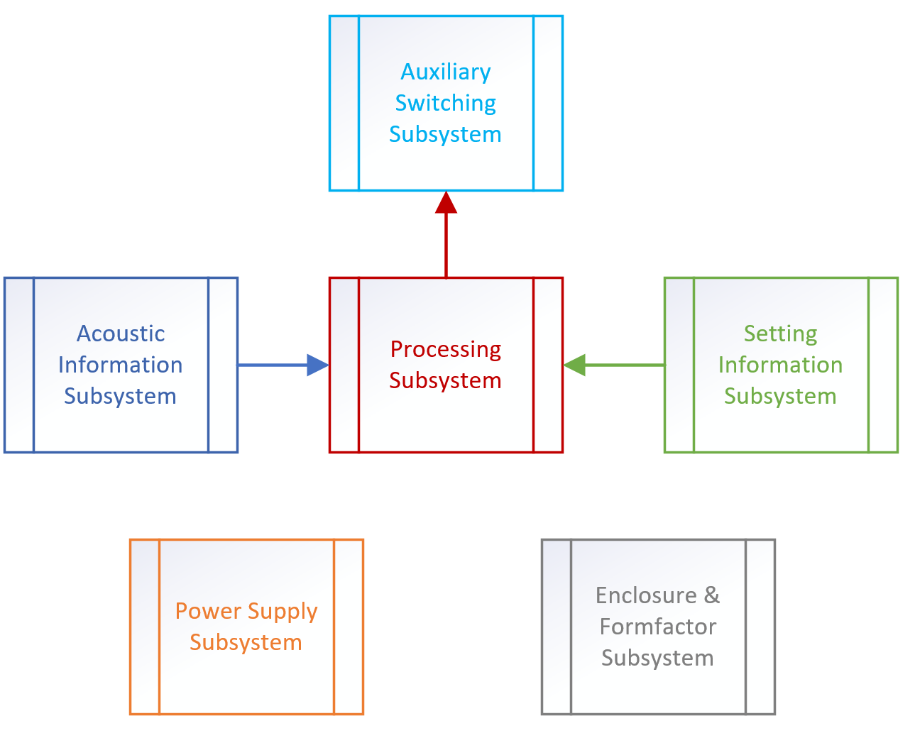
High Level Schematic Subsystems

Slide 5
Alternatives
Microcontroller
ATmega328PB | Chosen for familiarity/ease of use and low cost and for power requirements (1.8V – 5.5V)
ATSAMD21G18 | Unsuitable due to unfamiliarity
ATMega2560 | Unsuitable due to high cost and stringent power requirements (4.5V-5.5V)
Threshold Calculation
Data Analysis Method | Selected for high accuracy
Static dB Level | Easy to implement, but not accurate because environments vary in ambient level and standard deviation, customer preferred
dB Interrupt-Factor Method X dB = ambient*C | More accurate than a static dB level but does not account for ambient level

Slide 6
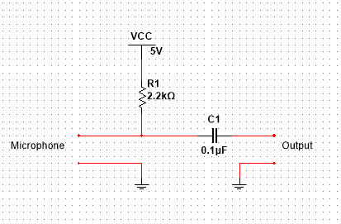
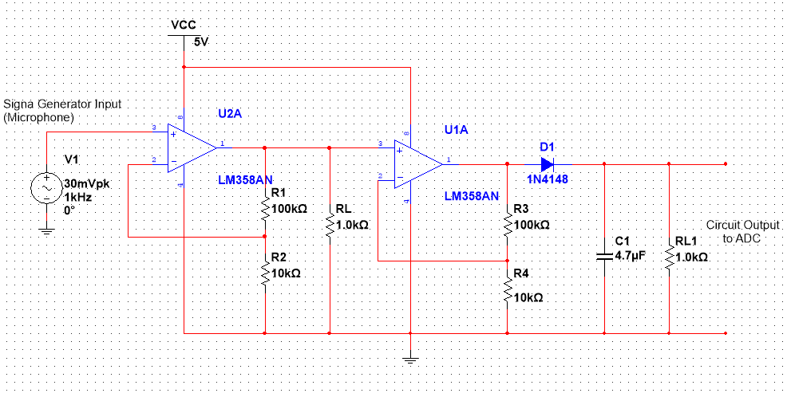
Microphone
Amplifier Design
Tested in senior design lab with an ambient noise level of 52.3dB
Microphone had a voltage output between 28 –34mV
Amplifiers in a cascaded configuration to achieve proper gain.
Rectifier circuit used to obtain a clean DC output for the microcontrollers’ ADC.

Slide 7
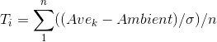
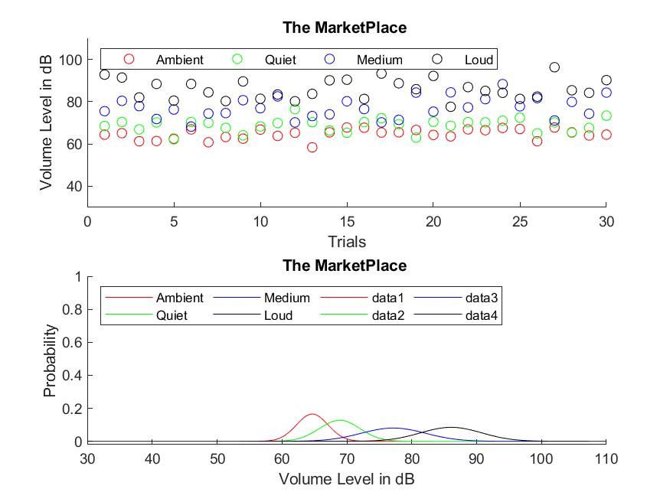
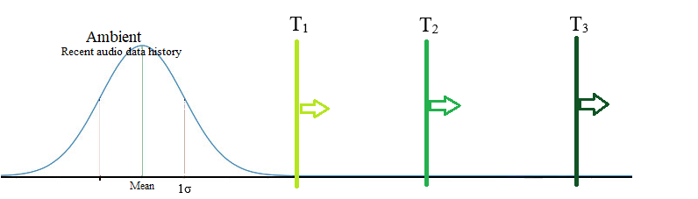
Sample Environments with Interrupt Levels
Shows 30 data points for each environment for ambient levels, as well as three manually generated interrupt levels
Normal distribution functions are used to show each sound level’s probability
The minimum threshold levels are plotted alongside the ambient
Requirement of <1% False Detection Rate: Receiver Operating Characteristic

Slide 8
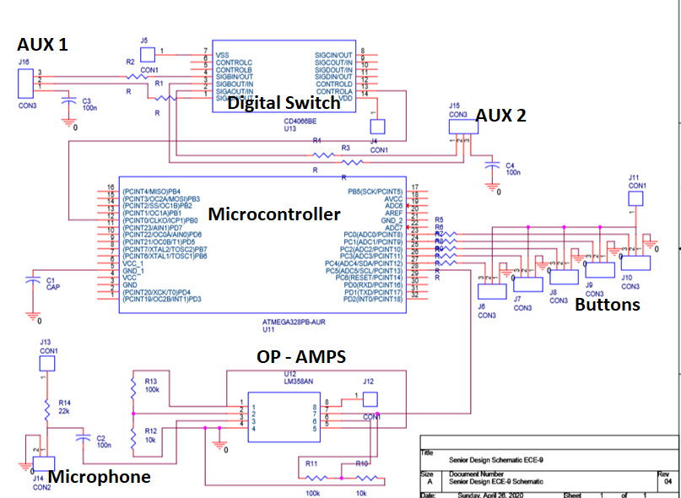
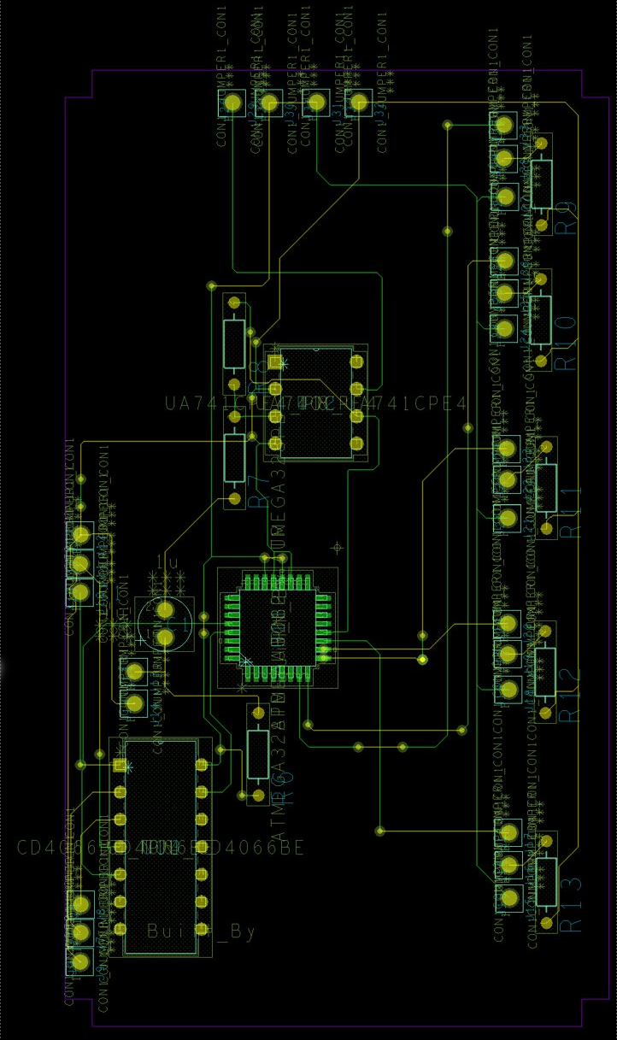
Updated PCB Layout Schematic
PCB Layout at maximum size constraint

Slide 9
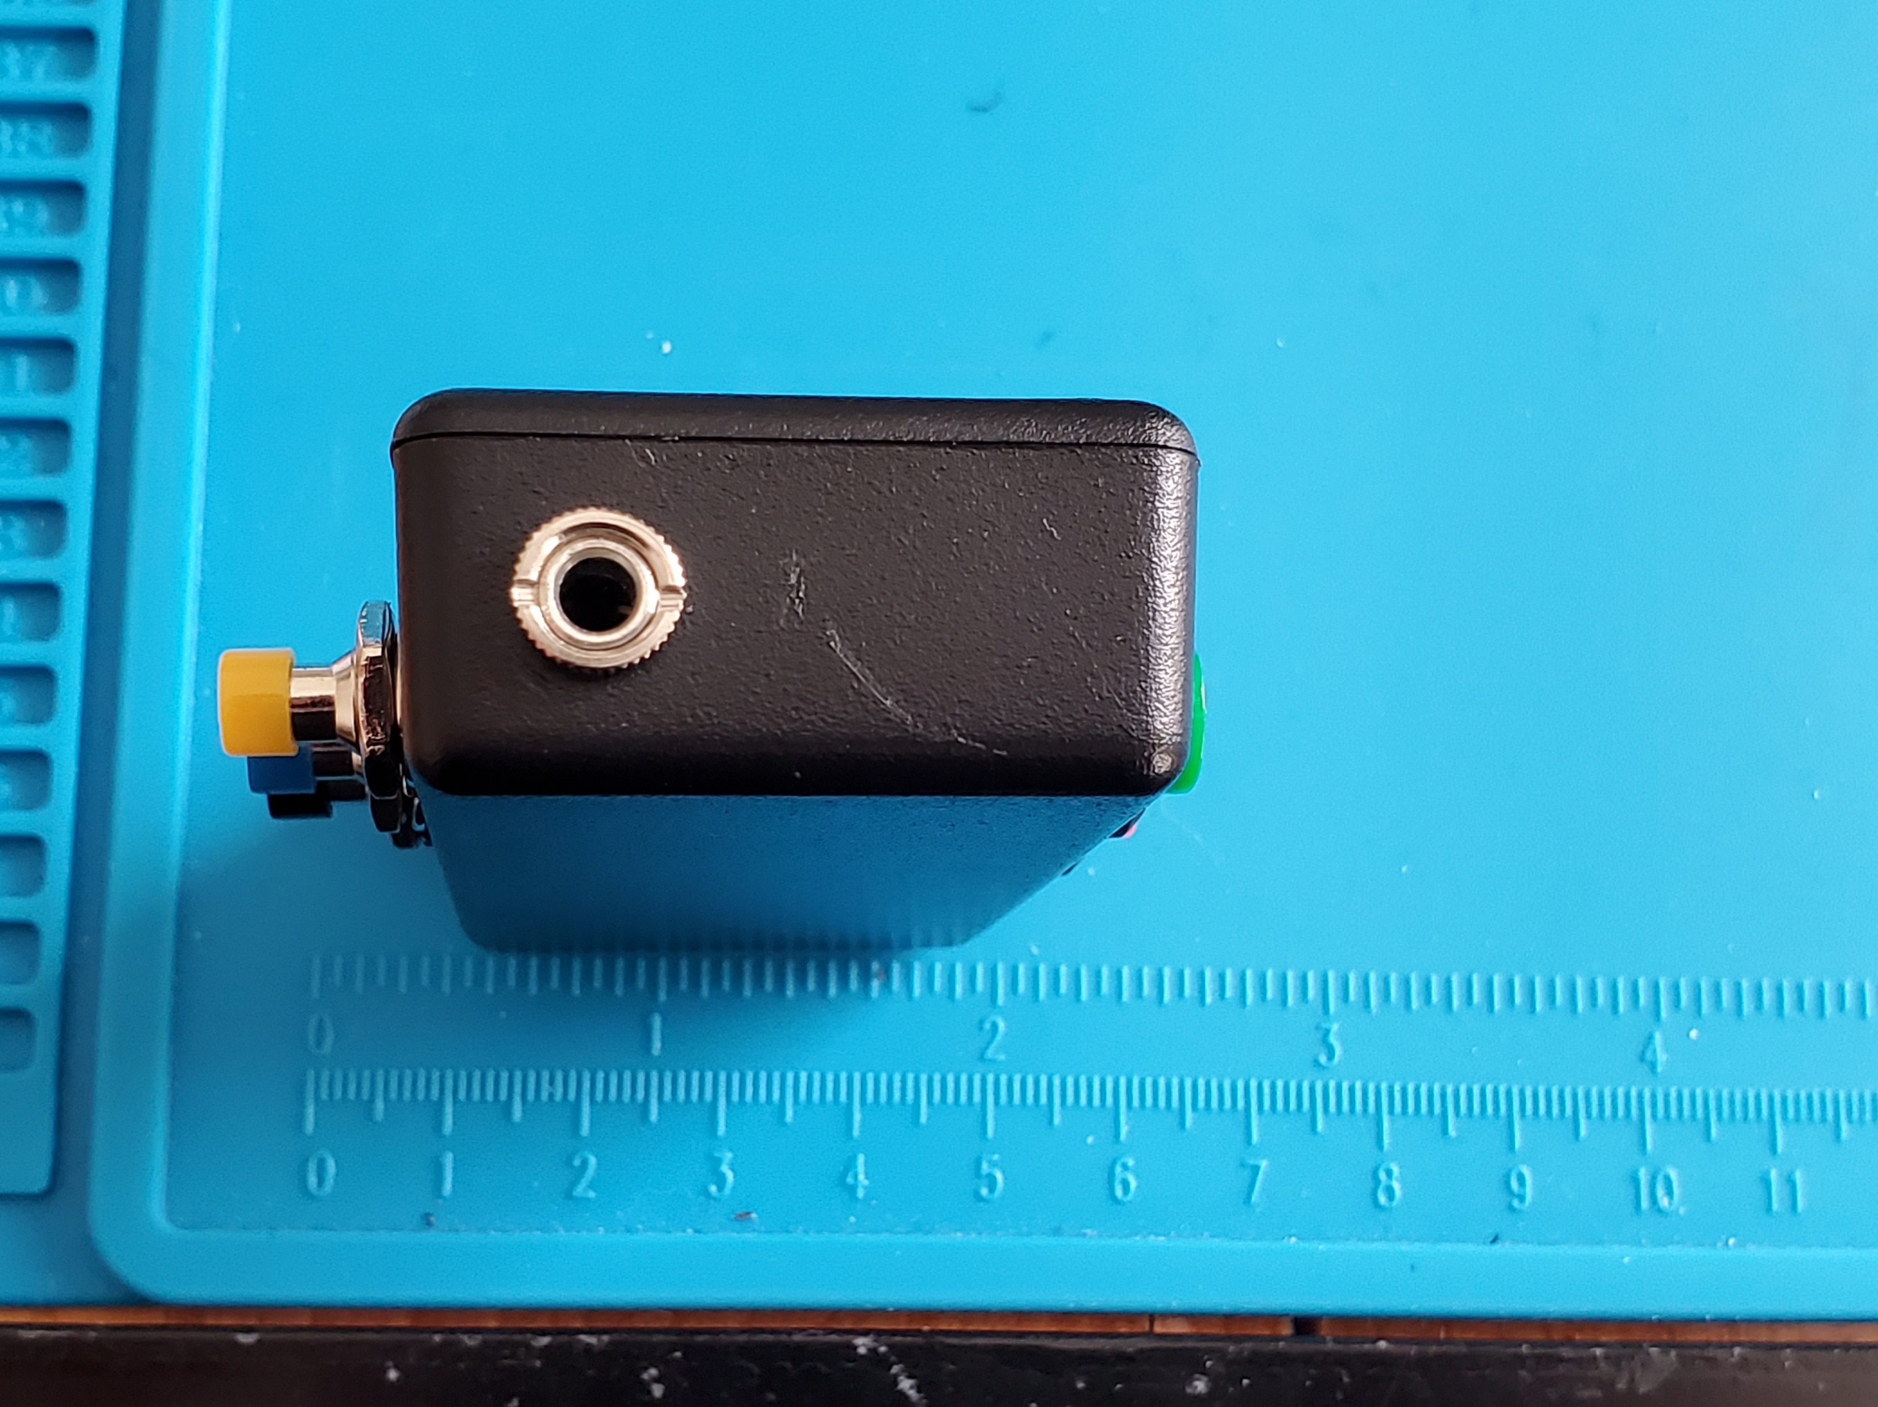
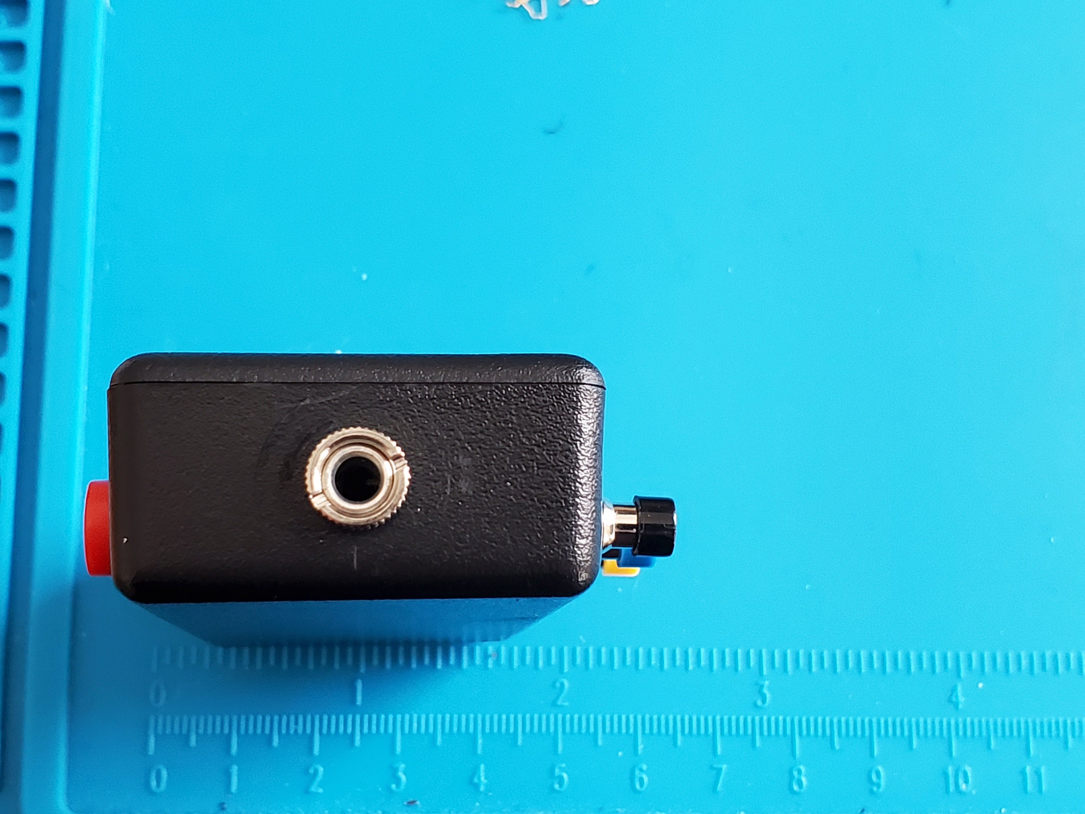
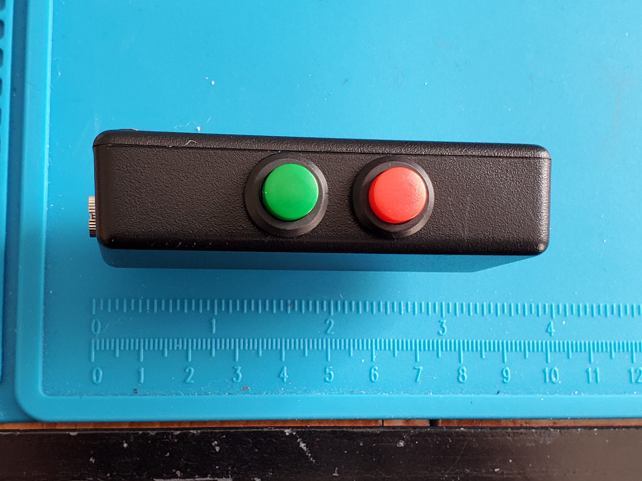
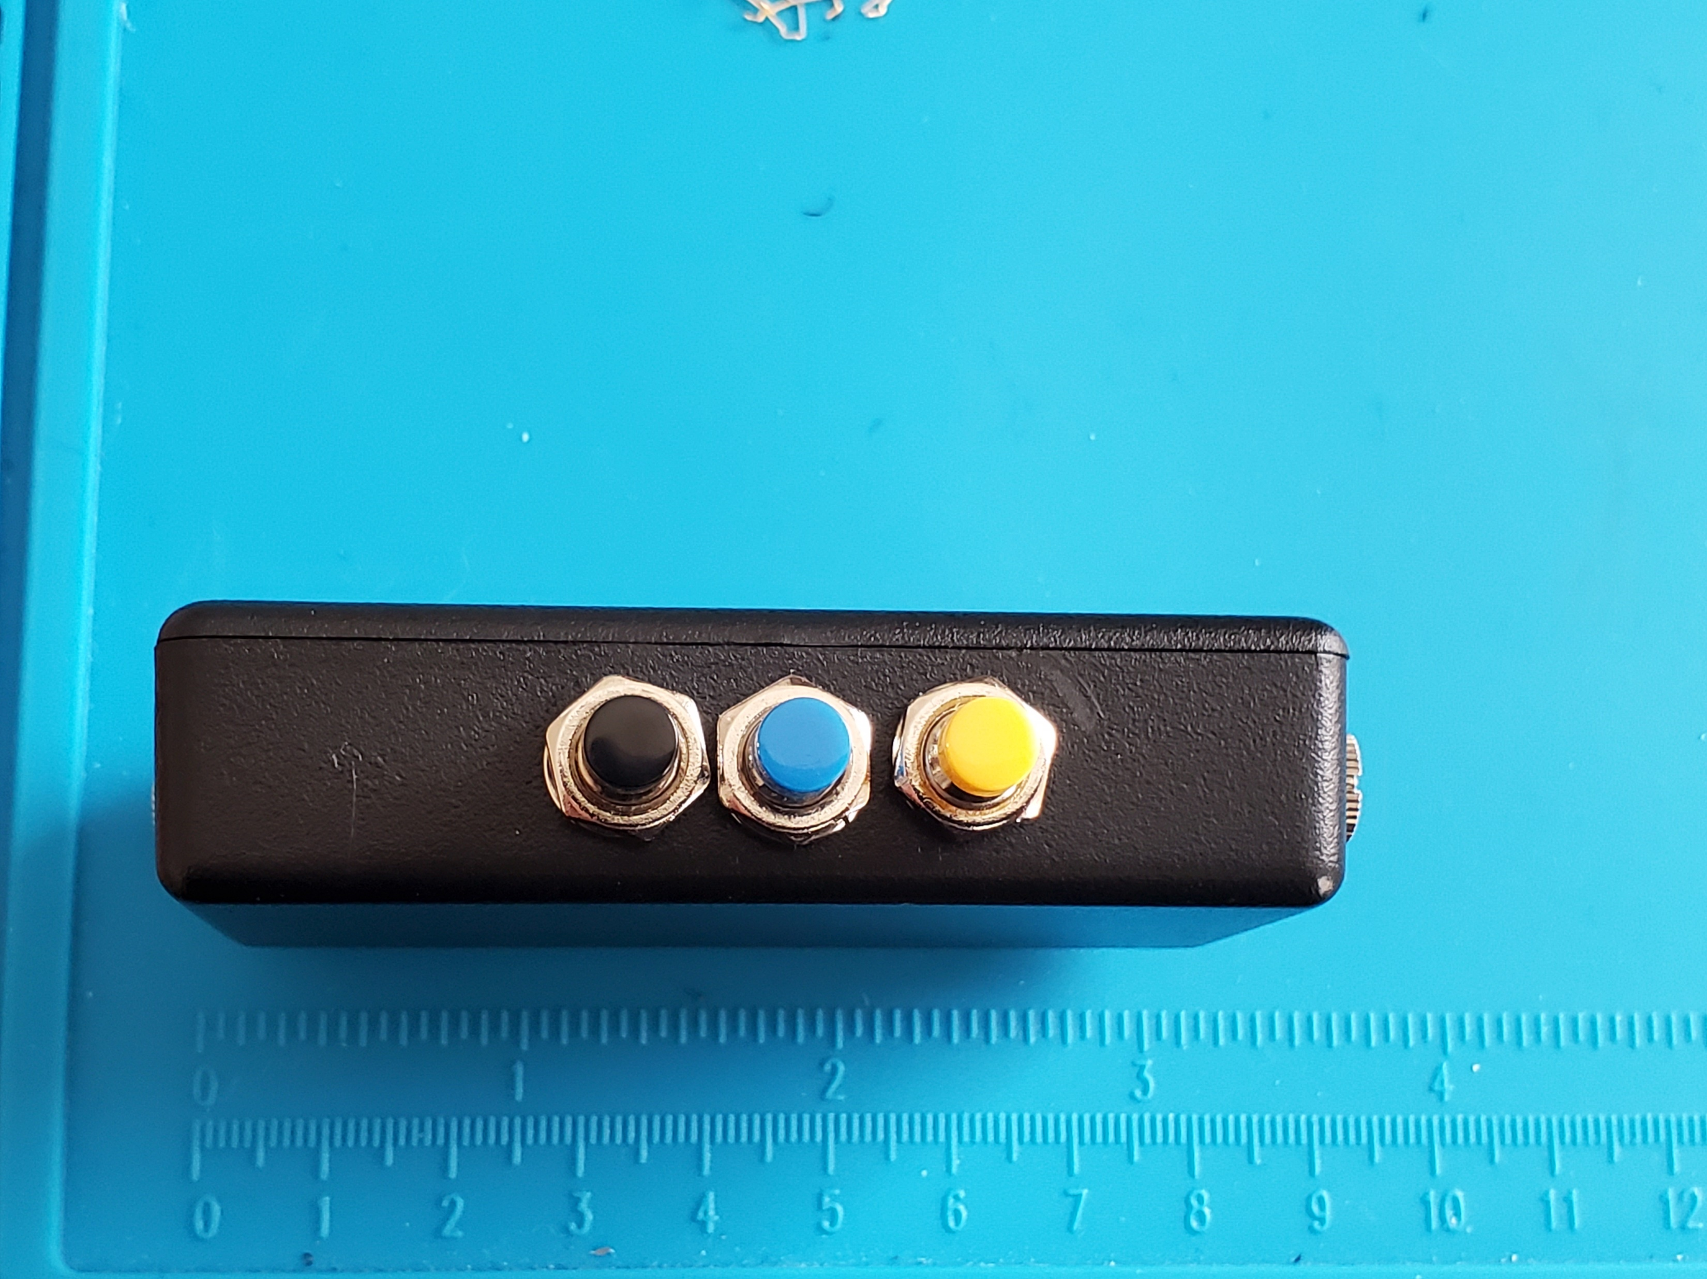
Enclosure
Intended Location for Micro-USB Port
Input Audio Jack
Output Audio Jack
Power
Medium Sensitivity
Reset
High Sensitivity
Low Sensitivity
Side A
Side B
Side C
Side D

Slide 10
Microcontroller Programming
The main program contains 3 main parts:
Initialization (Initializes variables/arrays, I/O, ADC, Timer1 Interrupt and Pin Change Interrupt.
Timer1 Interrupt Service Routine (100 Hz)
Pin Interrupt Service Routine (When Button is pressed)
Timer1 ISR:
This interrupt is invoked once every 10ms, is non-atomic (Pin Change ISR can interrupt it) and during the interrupt:
Reads the ADC and stores it
Computes 2s Average and stores it
Computes 20s Average and Standard Deviation
Compares Standard Deviation to Threshold Level
When the array of ADC numbers and 2s Averages is full and a new ADC value or a new 2s Average arrives, the old values get overwritten.
Pin Change ISR:
This interrupt is invoked when one of the buttons for PINC4:0 is pressed. This interrupt is atomic, no other interrupts can interrupt it until the ISR is finished.
For debugging purposes, PIND3 and PIND1:0 are LED outputs that represent what sensitivity mode the device is set to (see demo video).
ATmega328PB I/O | Function | Description
PINC5 | ADC | Reads Microphone
PINC4 | Button | On/Off Button
PINC3 | Button | Restart Button
PINC2:0 | Buttons | Threshold Sensitivity Buttons
PINB1:0 | Output | Switches the Auxiliary Ports on and off
PIND3 & PIND1:0 | Output | LED Outputs to show Sensitivity Mode (Debugging)

Slide 11
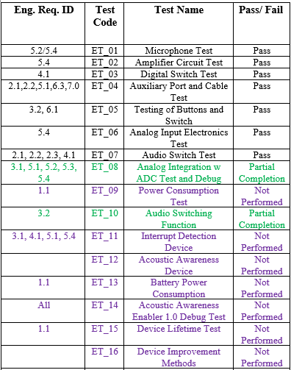
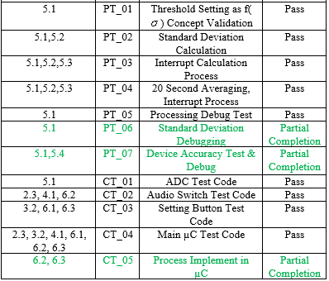
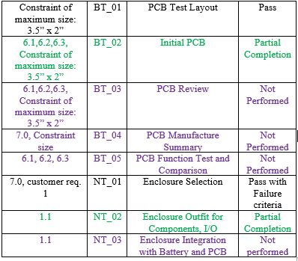
COVID-19 | Partial

Slide 12
Updated Schedule

Slide 13
Impact of COVID-19
Emphasis:
Project Functionality
Design
Simulations and Processing
De-emphasis:
Integration
Lab tests
Added Constraints:
Lab availability
Online group meetings

Slide 14
Summary
The major benefit to customer is for personal use and convenience
Future groups could work with threshold calculation more and work with spectral analysis to filter out interrupts based on spectrum
This could be used to decrease the false detection rate by filtering undesired sounds - - human voice spectrum differs from unnecessary noise

Slide 15
Demonstrations

Slide 16
Questions?

